Slide 1
Radiation in Medicine and Nuclear Reactors

Slide 2
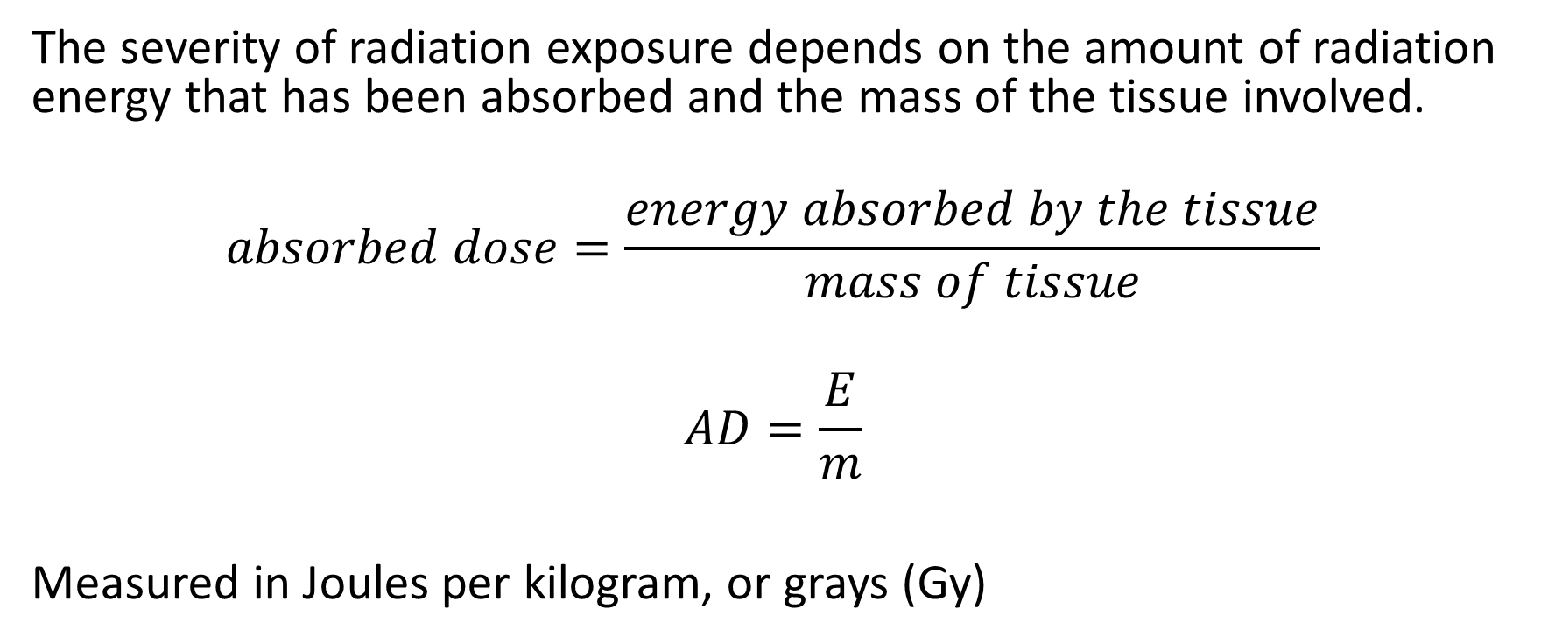
Radiation Exposure
The severity of radiation exposure depends on the amount of radiation energy that has been absorbed and the mass of the tissue involved.
$$absorbed dose=\frac{energy absorbed by the tissue}{mass of tissue}$$
$$AD=\frac{E}{m}$$
Measured in Joules per kilogram, or grays (Gy)

Slide 3
Dose equivalent
Absorbed dose is not widely used- It does not take into account the type of radiation involved.
Dose Equivalent (DE) is what is used, as it takes this into consideration.
Alpha particles are the most ionising form of radiation. They will interact with and ionise almost every atom in their path. Due to this, an absorbed dose of Alpha radiation is about 20 times more damaging to human tissue than an equal dose of beta or gamma radiation.

Slide 4
Quality factor
The weighting of the biological impact is called the quality factor (QF) .
A higher quality factor means that form of radiation is more damaging to humans.
Radiation | QF
Alpha | 20
Neutron | 10
Beta | 1
Gamma | 1
X-rays | 1

Slide 5

Dose equivalent
$$dose equivalent=absorbed dose ×quality factor$$
$$DE=AD ×QF$$
Measured in Sieverts (Sv)

Slide 6
Diagnosis
The radioisotope used depends on the site of the suspected tumour.
The body naturally distributes different elements to different organs.
Example- Iodine is sent to the thyroid gland by the liver, so is used to detect thyroid cancer.
When the tracer has reached the target organ, a radiation scan is taken with a gamma-ray camera. An unusual pattern on the scan indicates a possible cancerous tumour.

Slide 7
Diagnosis
The radioisotopes used for this type of diagnosis need to be gamma ray emitters. Why?
A-So the radiation has enough penetrating ability to pass out of the body to the camera.
It should have a short half-life. Why?
A-So the patient is not subjected to any unnecessary long-term exposure to radiation.

Slide 8
Treatment
Rapidly dividing cancerous cells are more susceptible to radiation than healthy tissue, so radiation is often used in cancer treatment.
Some sources can be used to specifically target only the cancerous tissue, such as Co-60

Slide 9
Nuclear Reactors

Slide 10
Parts of a nuclear reactor
Fuel rod
Moderator
Control rod
Coolant
Radiation shield

Slide 11
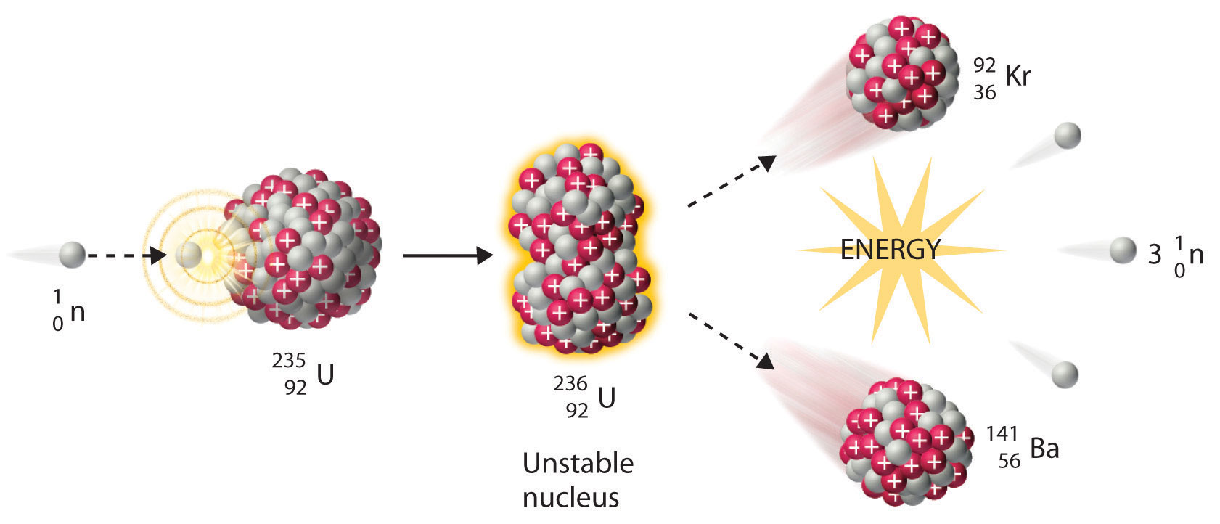

Slide 12
Fuel Rods
Usually U-235. This isotope comprises only 0.7% of naturally occurring Uranium, which is not enough to sustain a nuclear reaction.
The predominant isotope, U-238 is non-fissile.
Uranium ore needs to be enriched before it can be used in a reactor, to get the U-235 content up to about 4%.
As the name suggests, this is the ‘fuel’ of the fission reactions that occur.

Slide 13
Moderator
Fast moving neutrons are hard to control, and are not captured by nuclei, instead they bounce off. In order for them to be controlled, their speed needs to be reduced.
The moderator is a material that moderates, or slows down, these free neutrons.
Substances with small nuclei will slow down the neutrons to speeds where they can be captured by a fissile nucleus.
When neutrons hit these small nuclei, they lose most of their kinetic energy, so slow down.
Common materials are carbon, water, carbon dioxide, heavy water etc.

Slide 14


Slide 15
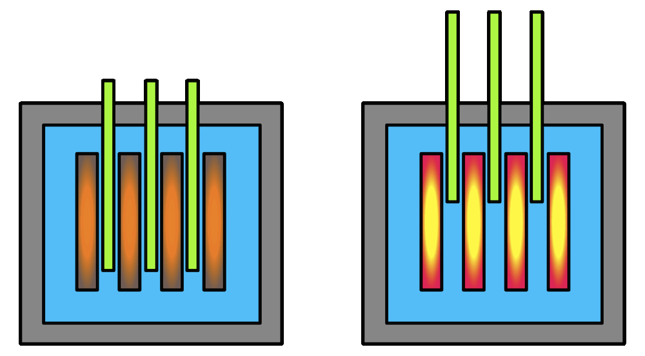
Control Rods
In fission reactions, the number of neutrons released grows exponentially
Control Rods absorb these extra neutrons in order to CONTROL the rate at which the reaction proceeds.
Often Cadmium or Boron
Representative diagram of control rod usage. The left image shows the control rods (green) inserted fully into the reactor core, putting the reactor in a subcritical state. In the right image, the control rods are removed, allowing more neutrons to accelerate the fission chain reaction and go supercritical.

Slide 16
Coolant
The fission reaction in the core (where fuel and control rods are) produces an enormous amount of heat.
Temperatures are typically in a range of 500-1500°C.
This excess heat energy is removed by the coolant, which are substances with high specific heat capacities. Liquid sodium, water, carbon dioxide or heavy water

Slide 17
Radiation Shield
The corer of the reactor is encased in a protective radiation shield consisting of layers of concrete, steel, graphite and lead.
The total thickness is usually about 2 meters.
This shield prevents gamma rays and neutrons from escaping the reactor, protecting workers from damaging radiation.

